Slide 1


CSC272
Chapters 1-7

Slide 2
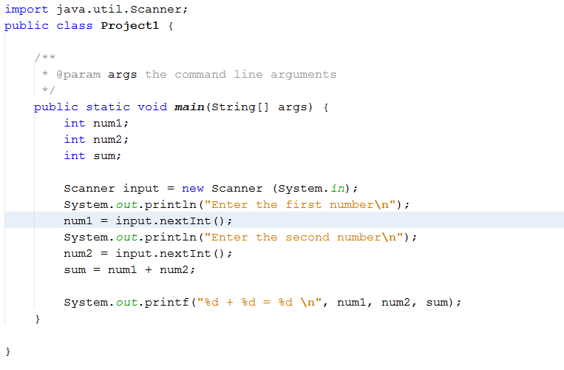
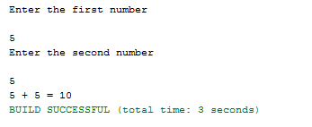
Adding two integers
Scanner class, and nextInt() method.

Slide 3
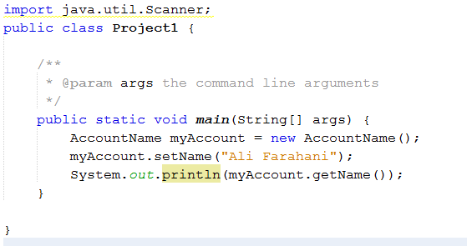
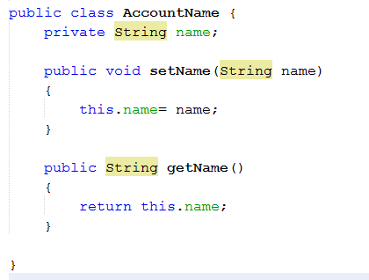

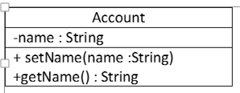
Account class- version 1
UML diagram
1. Set and get methods.
2. this pointer.
2.Instantiate a class.
2. Input.nextLine()

Slide 4
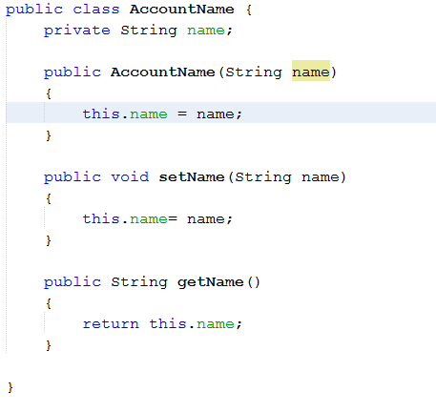
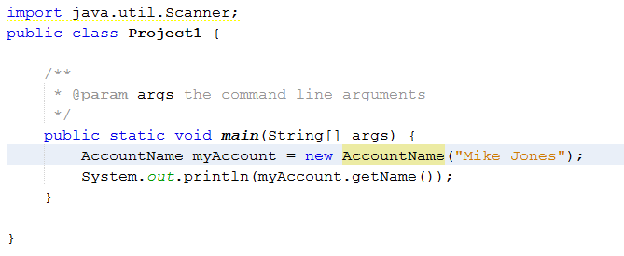

Account class- version 2
Account
-name : String
<<Constructor>> AccountName(name :String) + setName (name :String) +getName () : String
Class constructor

Slide 5
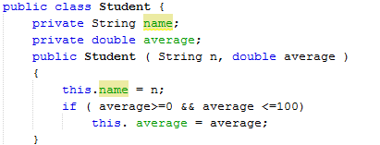

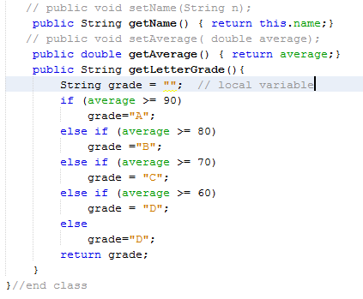
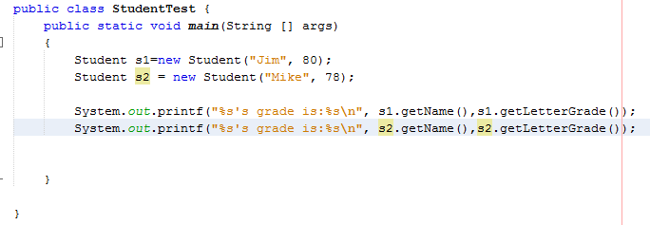
Student class:
Conditional if-else statement
Students class: conditional statement

Slide 6
Lab 1 – Student Activity
Problem #1:
Body Mass Index (BMI) is a measure of health on weight. It can be calculated by taking your weight in kilograms and dividing by the square of your height in meters. Write a program that prompts the user to enter a weight in pounds and height in inches and displays the BMI. Note that one pound is 0.45359237 kilograms and one inch is 0.0254 meters.
Your program should also display the following report:
BMI Values:
Serious underweight below 18
Underweight : less than 16 - 18
Normal weight between 18 - 24
Overweight: between 24 – 29
Seriously overweight between 29 - 35
Obese: 35 or greater
For example:
Welcome to the body mass index (BMI) calculator
Enter your weight in pounds: 200
Enter your height in inches: 71
Your BMI is: 27

Slide 7
Lab 2 – Student Activity
Problem #2
Create a class called Invoice that a hardware store might use to represent an invoice for an item sold at the store. An Invoice should include four pieces of information as instance variables – a part number (type string), a part description (type string), a quantity of the items being purchased (type int) and a price per item (double). Your class should have a constructor that initializes the four instance variables. Provide a set and get methods for each instance variable. In addition, provide a method named getInvoiceAmount() that calculates the invoice amount ( i.e multiplies the quantity by the price per item), then returns the amount as a double value. If the quantity is not positive, it should be set to 0. If the price per item is not positive, it should be set to 0.0. Write a test app named InvoiceTest that demonstrates class Invoice’s capabilities.

Slide 8
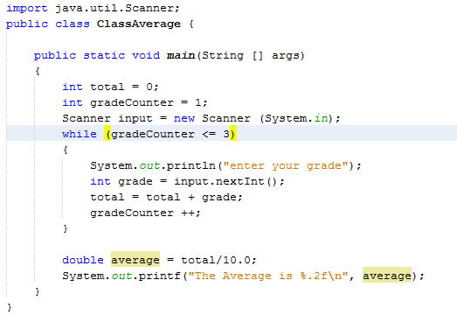
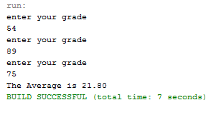
Counter controlled loops
While loops
We can add validations before assigning values to instance variables. Additional methods for deposit and withdraw can be added as well. Use input.nextDouble() to read floating point numbers
Integer division produces an integer
Always validate user input and range check

Slide 9
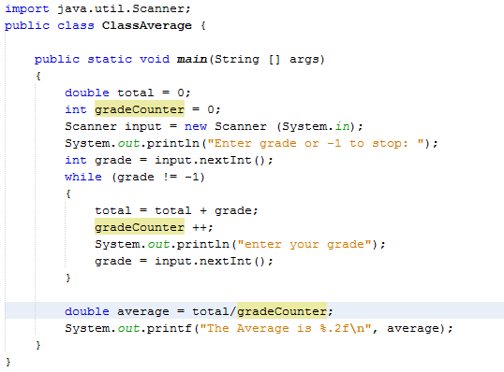
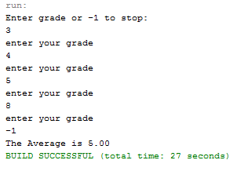
Sentinel controlled While loop

Slide 10
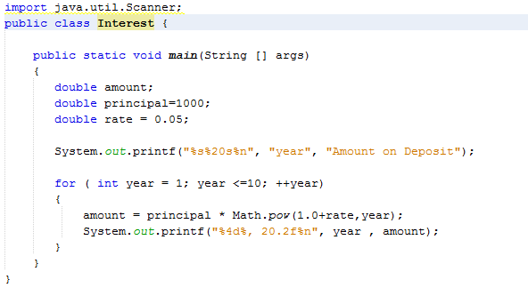
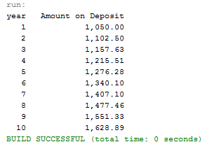
For loop – compound interest
computation
Static method Math.pow()

Slide 11
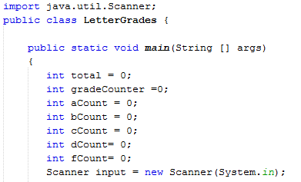
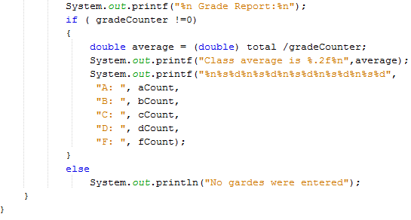
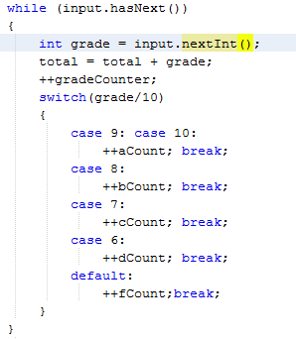
Switch statement to count grades
Note the hasNext() method in the while loop.

Slide 12
Lab 3 – Student Activity
Problem#3
An online retail store sells five products whose retail prices are as follows:
Product1, $2.98
Product2, $4.50
Product3, $9.98
Product4, $4.49
Product5, $6.87
Write an application that reads a series of pairs of numbers as follows
Product number
Quantity sold
Your program should use a switch statement to determine the retail price for each product. It should calculate and display the total retail value of the products sold. Use sentinel controlled loop to determine when the program should stop looping and display the final result.

Slide 13
Static methods, static fields, Math class
Chapter 6
Static method: no need to create an object to call methods in the class. Use class name, <className.methodName>
Static field: Also class variable is shared among all objects.
Math class in java has many static method such as abs(x), ceil(x) .. See page 204
The Math class has constants Math.PI and Math.E

Slide 14
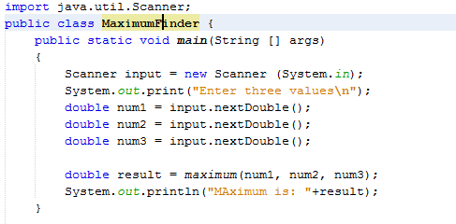
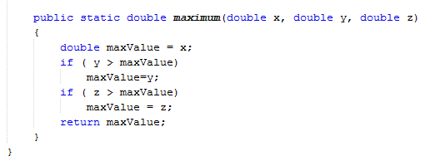
Max. of three numbers
Static method can call other static method in
the same class directly, as seen in this example.
Any other class must use the fully qualified name of
maximum method.
We can also use Math.max(x, Math.max(y,z))
Note the string concatenation here with + result. Primitive values used
in string concatenation are converted to strings. Objects have a
toString() method

Slide 15
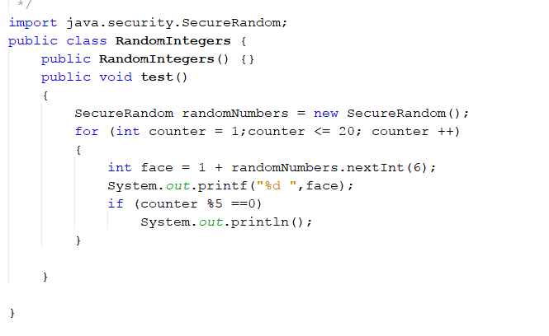

Random Number generator
SecureRandom() object is non deterministic random number generator.

Slide 16
Method overloading
Functions having the same name but different sets of parameters ( determined by the number, types and order of the parameters).

Slide 17
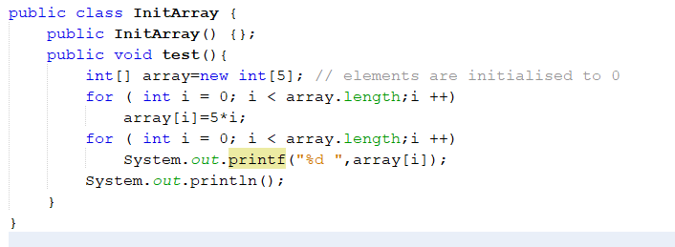

Chapter 7: Arrays
Creating an array:
Int[] myArray= new int[10];
Int[] myArray= { 2, 4, 6, 8, 9};
Final int SIZE=10;
Int[] myArray = new int[SIZE];
Length of an array gives the number of elements in the array.

Slide 18
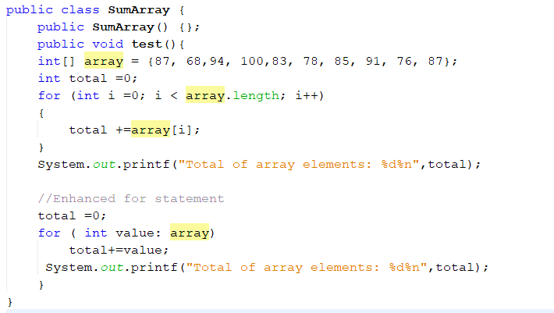

Summing Elements of an
Array
Format specifier : %2d an integer with two digits
Enhanced for loop

Slide 19
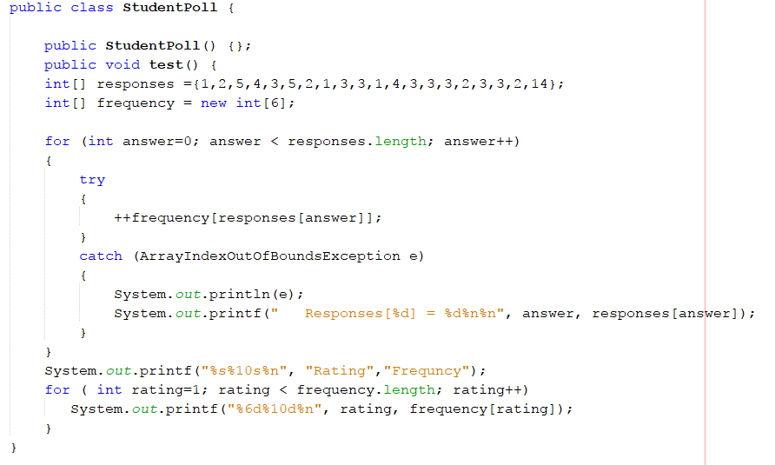
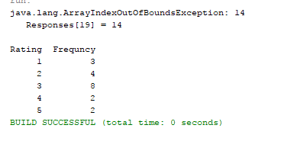
Arrays for survey results and exceptions
Printing (e) activates e.toString() method.

Slide 20
Arrays for Survey results and exceptions
Printing (e) activates e.toString() method.

Slide 21
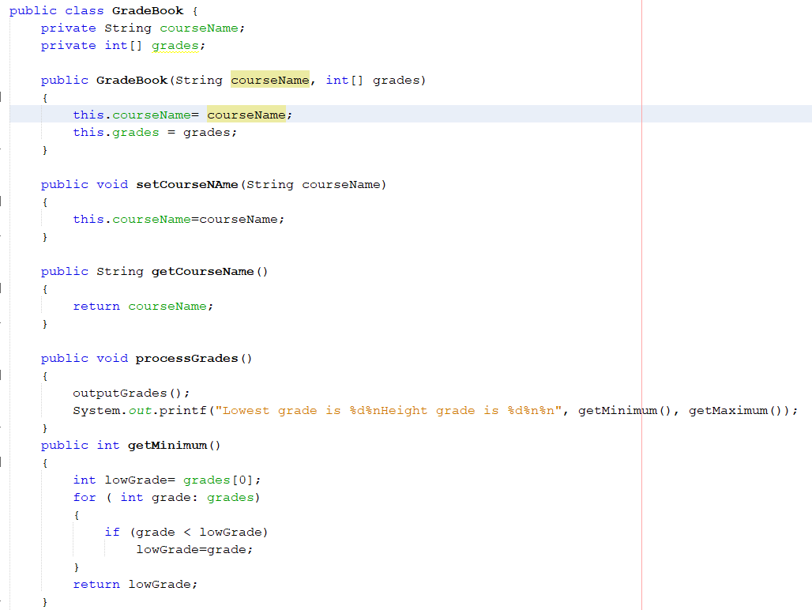
Passing arrays to functions
In java all arguments are passed by value.
Changes made by a reference parameter by calling methods
is permanent.

Slide 22
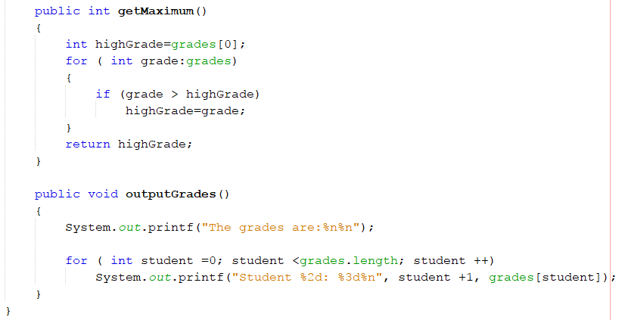
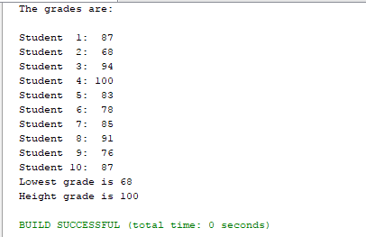
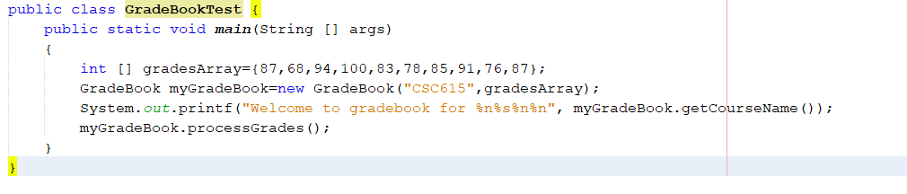
Continued from previous slide

Slide 23
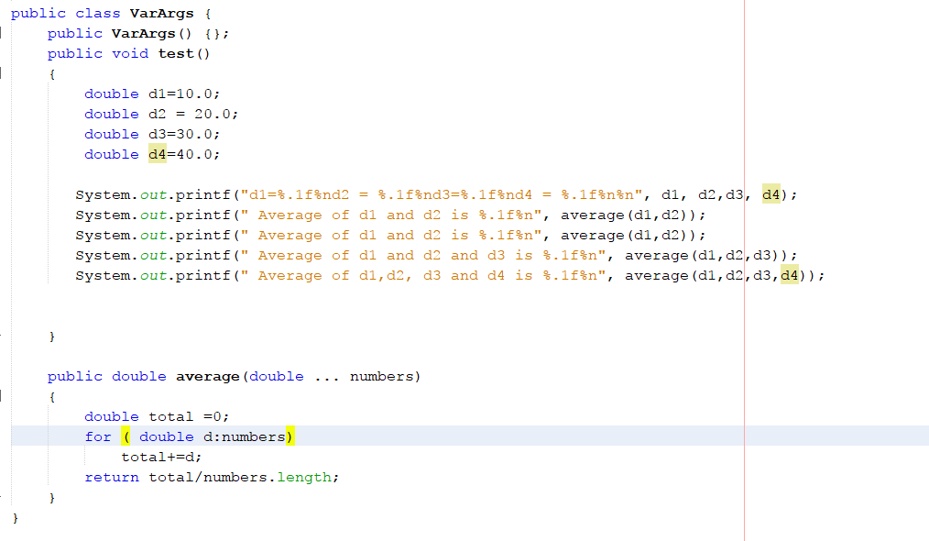
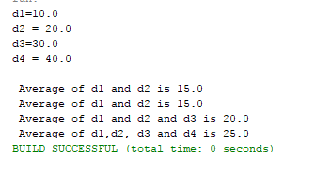
Continued from previous slide
Variable argument list.

Slide 24
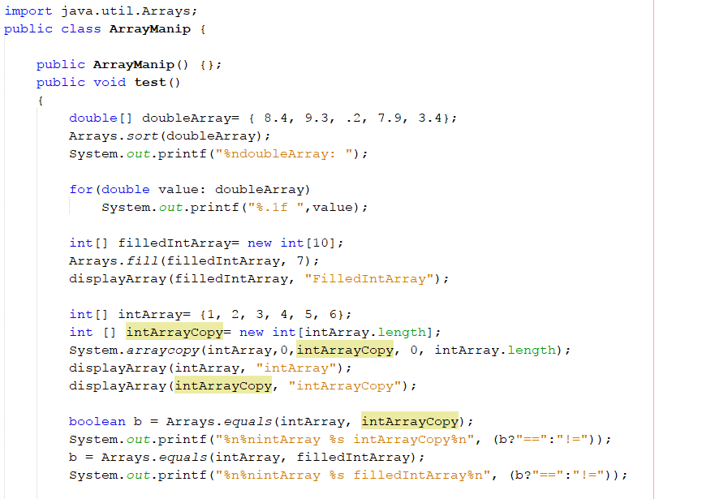
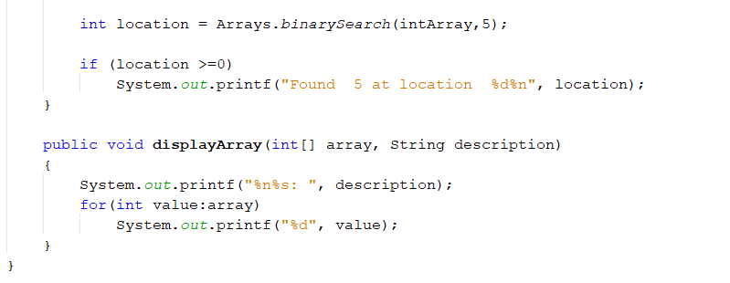
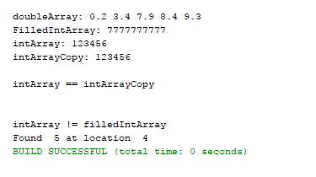
Class Array
Methods:
Sort(), fill(), equals(), binarySearch(),
System.arrayCopy()

Slide 25
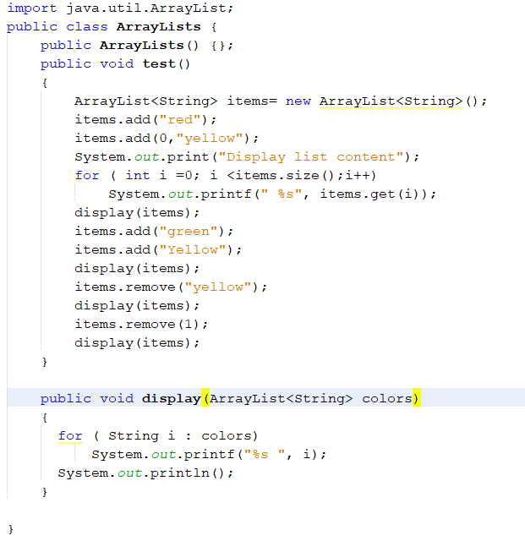
Java collections:
the class ArrayList
ArrayList, automatically changes size.
ArrayList<T> is in package java.util.
Methods: see page 288
Add()
Clear()
Contains()
Get()
indexOf()
Remove()
Size()
trimTosize()

Slide 26
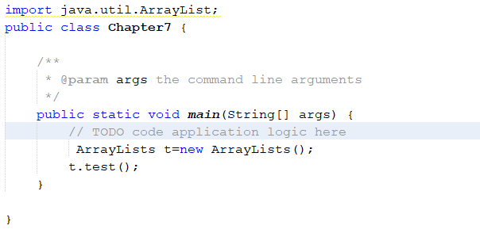

Continued from previous slide

Slide 27
Lab 4 – Student Activity
Problem#4
Write an application to simulate rolling of two dice. The application should use the object of class SecureRandom once to roll the first die and again to roll the second die. The sum of the two values will vary from 2 to 12, with 7 being the most frequent sum, and 2 and 12 the least frequent. Your application should roll the dice 36,000,000 times. Use a one-dimensional array to tally the number of times each possible sum appears. Display the array.

